Slide 1
Digital Signal Processing(BEC-303)
Unit-1
Lecture-7

Slide 2
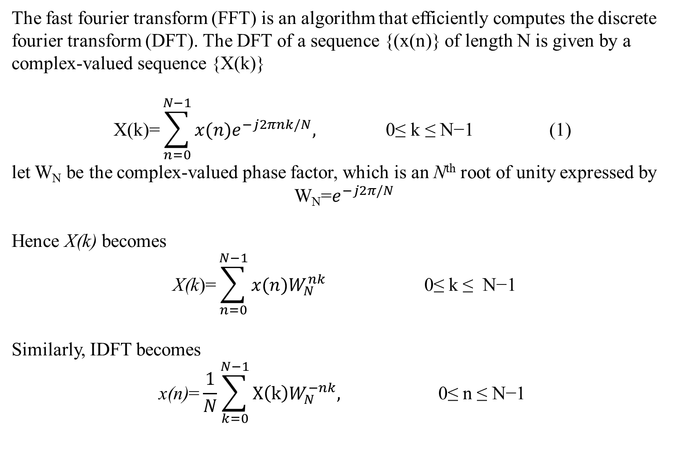
FAST FOURIER TRANSFORM
The fast fourier transform (FFT) is an algorithm that efficiently computes the discrete fourier transform (DFT). The DFT of a sequence {(x(n)} of length N is given by a complex-valued sequence {X(k)}
$$\text{X}\text{(}\text{k}\text{)=}\sum_{n=0}^{N−1}{x(n)e^{−j2πnk/N}\text{, }\text{0≤} \text{k} \text{≤} \text{N}\text{−1 (1) }}$$
let W_{N} be the complex-valued phase factor, which is an N^{th} root of unity expressed by
W_{N}=$e^{−j2π/N}$
Hence X(k) becomes
$$\text{X}\text{(}\text{k}\text{)=}\sum_{n=0}^{N−1}{x(n)W_{N}^{nk}}\text{ 0≤} \text{k} \text{≤} \text{N}\text{−1}$$
Similarly, IDFT becomes
$$\text{x}\text{(}\text{n}\text{)}\text{=}\frac{1}{N}\sum_{k=0}^{N−1}{X\left(k\right)W_{N}^{−nk},}\text{ 0≤} \text{n}\text{ ≤ }\text{N}\text{−1 }$$

Slide 3
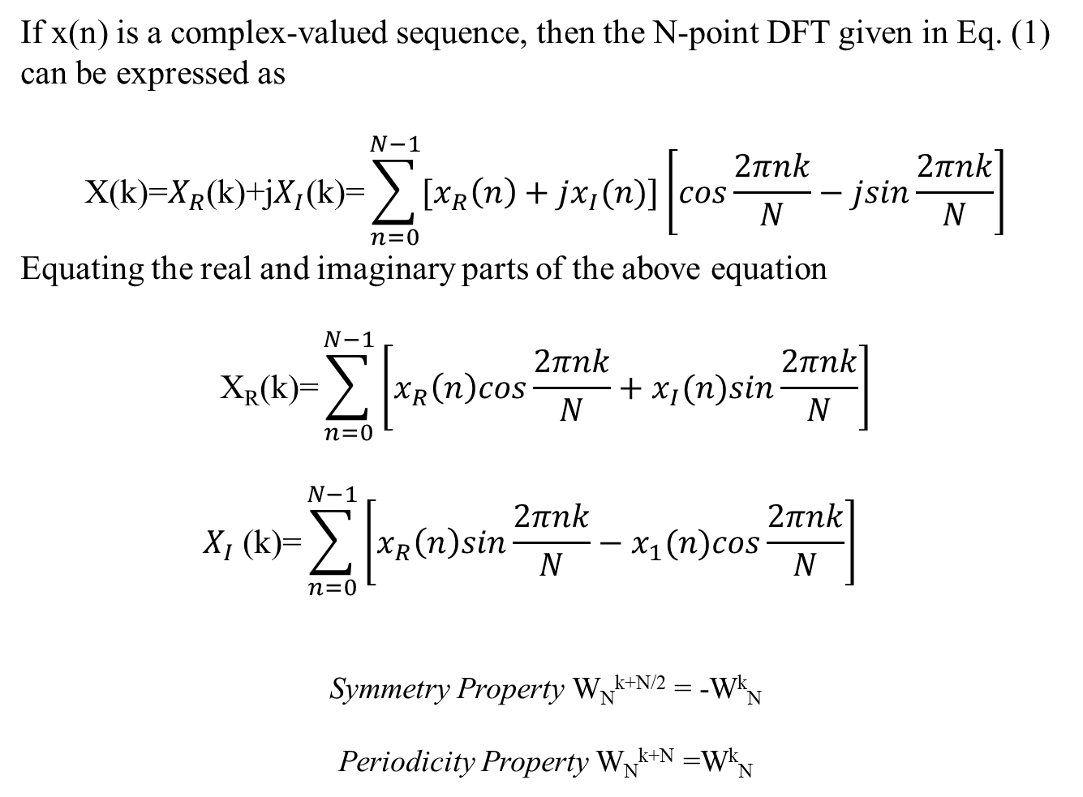
If x(n) is a complex-valued sequence, then the N-point DFT given in Eq. (1) can be expressed as
$$\text{X}\text{(}\text{k}\text{)=}X_{R}\text{(}\text{k}\text{)+}\text{j}X_{I}\text{(}\text{k}\text{)=}\sum_{n=0}^{N−1}{{[x}_{R}\left(n\right)+jx_{I}(n)]\left[cos\frac{2πnk}{N}−jsin\frac{2πnk}{N}\right]}$$
Equating the real and imaginary parts of the above equation
$$\text{X}\text{R}\text{(}\text{k}\text{)=}\sum_{n=0}^{N−1}{\left[x_{R}\left(n\right)cos\frac{2πnk}{N}+x_{I}(n)sin\frac{2πnk}{N}\right]}$$
$$X_{I} \text{(}\text{k}\text{)=}\sum_{n=0}^{N−1}{\left[x_{R}\left(n\right)sin\frac{2πnk}{N}−x_{1}(n)cos\frac{2πnk}{N}\right] }$$
Symmetry Property W_{N}^{k+N/2} = -W^{k}_{N}
Periodicity Property W_{N}^{k+N} =W^{k}_{N}

Slide 4
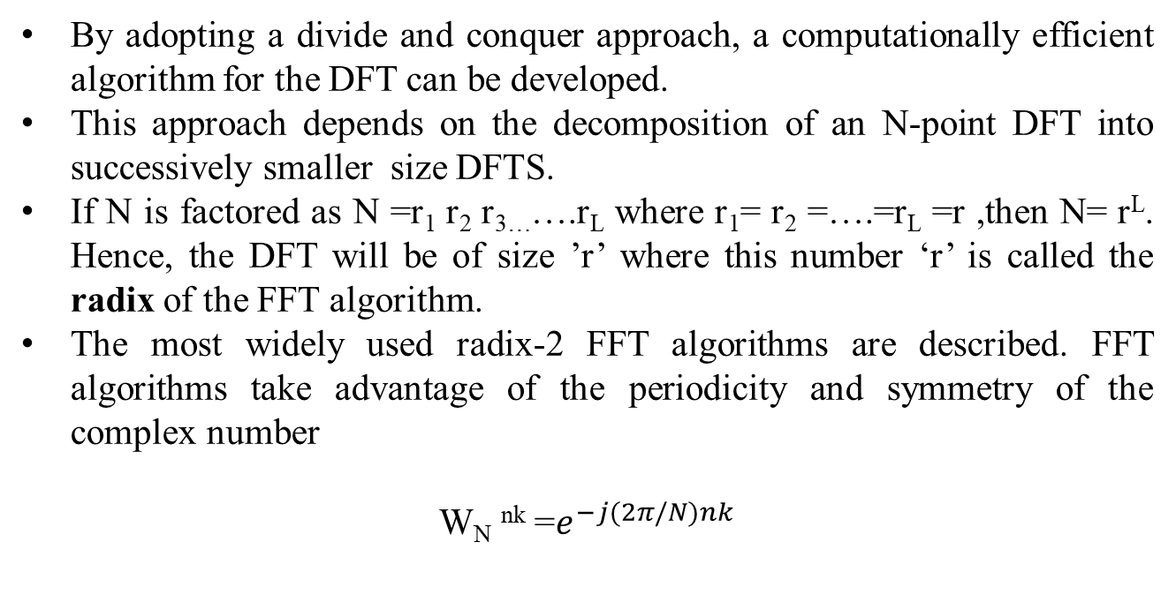
Radix-2 FFT
By adopting a divide and conquer approach, a computationally efficient algorithm for the DFT can be developed.
This approach depends on the decomposition of an N-point DFT into successively smaller size DFTS.
If N is factored as N =r₁ r₂ r_{3…}….r_{L} where r₁= r₂ =….=r_{L} =r ,then N= r^{L}. Hence, the DFT will be of size ’r’ where this number ‘r’ is called the radix of the FFT algorithm.
The most widely used radix-2 FFT algorithms are described. FFT algorithms take advantage of the periodicity and symmetry of the complex number
W_{N} ^{nk} =$e^{−j(2π/N)nk}$

Slide 5
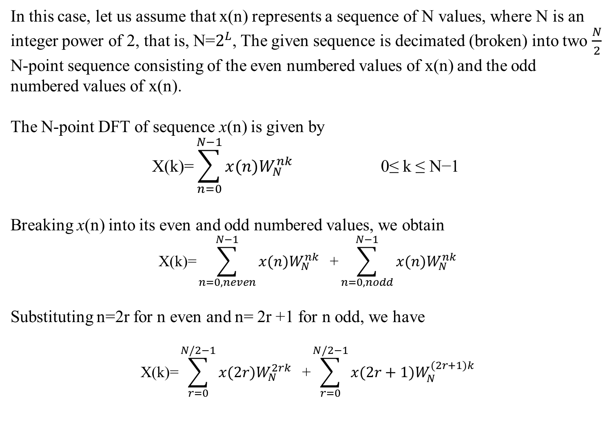
Decimation-in-Time(DIT) Algorithm
In this case, let us assume that x(n) represents a sequence of N values, where N is an integer power of 2, that is, N=$2^{L}$, The given sequence is decimated (broken) into two $\frac{N}{2}$ N-point sequence consisting of the even numbered values of x(n) and the odd numbered values of x(n).
The N-point DFT of sequence x(n) is given by
$$\text{X}\text{(}\text{k}\text{)=}\sum_{n=0}^{N−1}{x(n)W_{N}^{nk}}\text{ 0≤} \text{k} \text{≤} \text{N}\text{−1 }$$
Breaking x(n) into its even and odd numbered values, we obtain
$$\text{X}\text{(}\text{k}\text{)=}\sum_{n=0, neven}^{N−1}{x(n)W_{N}^{nk}}\text{ +}\sum_{n=0,nodd}^{N−1}{x(n)W_{N}^{nk}}$$
Substituting n=2r for n even and n= 2r +1 for n odd, we have
$$\text{X}\text{(}\text{k}\text{)=}\sum_{r=0}^{N/2−1}{x(2r)W_{N}^{2rk}}\text{ +}\sum_{r=0}^{N/2−1}{x(2r+1)W_{N}^{(2r+1)k}}$$

Slide 6
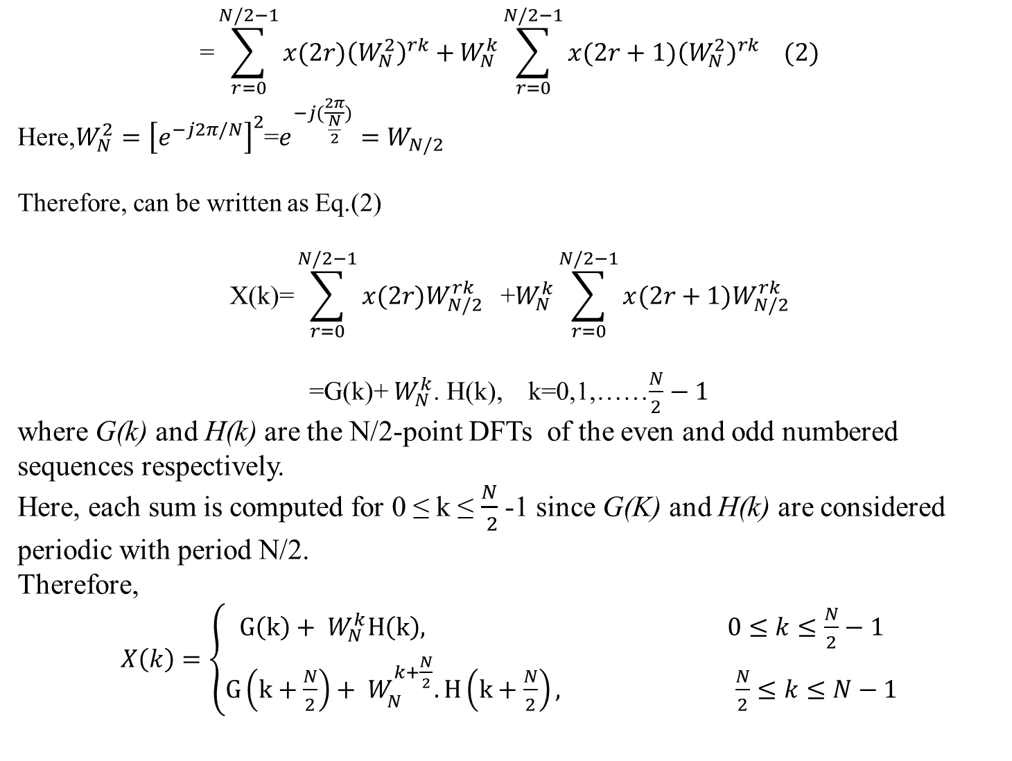
$$\text{=}\sum_{r=0}^{N/2−1}{{x(2r)\left(W_{N}^{2}\right)}^{rk}+}W_{N}^{k}\sum_{r=0}^{N/2−1}{{x(2r+1)\left(W_{N}^{2}\right)}^{rk} (2)}$$
Here,$W_{N}^{2}={\left[e^{−j2π/N}\right]}^{2}$=$e^{−j(\frac{2π}{\frac{N}{2}})}=W_{N/2}$
Therefore, can be written as Eq.(2)
$$\text{X}\text{(}\text{k}\text{)=}\sum_{r=0}^{N/2−1}{x(2r)W_{N/2}^{rk}}\text{ +}W_{N}^{k}\sum_{r=0}^{N/2−1}{x(2r+1)W_{N/2}^{rk}}$$
=G(k)+ $W_{N}^{k}$. H(k), k=0,1,……$\frac{N}{2}−1$
where G(k) and H(k) are the N/2-point DFTs of the even and odd numbered sequences respectively.
Here, each sum is computed for 0 ≤ k ≤ $\frac{N}{ 2}$-1 since G(K) and H(k) are considered periodic with period N/2.
Therefore,
$X\left(k\right)=\left\{\begin{aligned}G\left(k\right)+ W_{N}^{k}H\left(k\right), 0≤k≤\frac{N}{2}−1 \\ G\left(k+\frac{N}{2}\right)+ W_{N}^{k+\frac{N}{2}}.H\left(k+\frac{N}{2}\right), \frac{N}{2}≤k≤N−1\end{aligned}\right.$

Slide 7
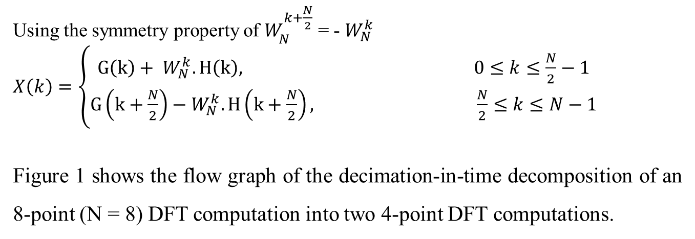
Using the symmetry property of $W_{N}^{k+\frac{N}{2}}$ = - $W_{N}^{k}$
$X\left(k\right)=\left\{\begin{aligned}G\left(k\right)+ W_{N}^{k}.H\left(k\right), 0≤k≤\frac{N}{2}−1 \\ G\left(k+\frac{N}{2}\right)−W_{N}^{k}.H\left(k+\frac{N}{2}\right), \frac{N}{2}≤k≤N−1\end{aligned}\right.$
Figure 1 shows the flow graph of the decimation-in-time decomposition of an 8-point (N = 8) DFT computation into two 4-point DFT computations.

Slide 8
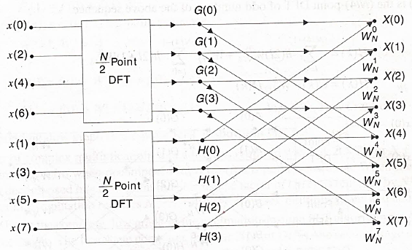
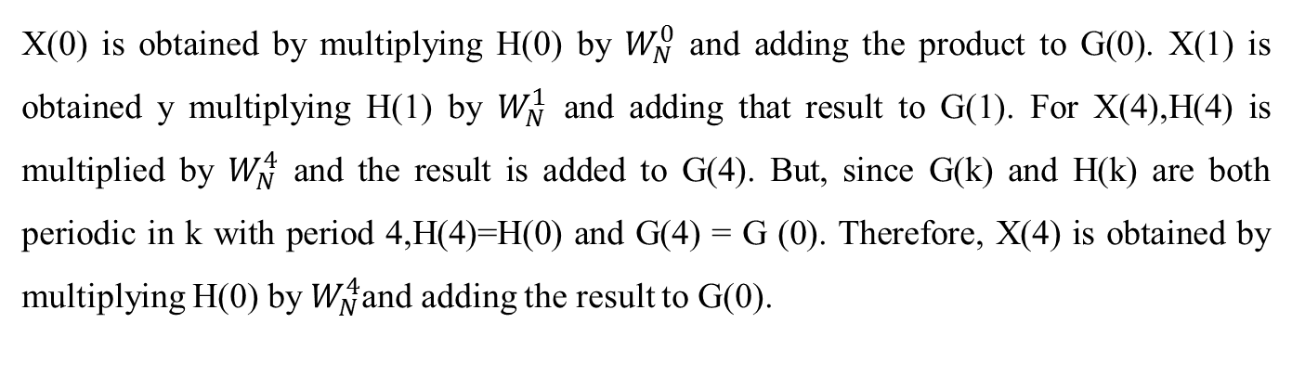
Figure:1 Flow graph of the second Stage Decimation-in-time FFT Algorithm for N=8
X(0) is obtained by multiplying H(0) by $W_{N}^{0}$ and adding the product to G(0). X(1) is obtained y multiplying H(1) by $W_{N}^{1}$ and adding that result to G(1). For X(4),H(4) is multiplied by $W_{N}^{4}$ and the result is added to G(4). But, since G(k) and H(k) are both periodic in k with period 4,H(4)=H(0) and G(4) = G (0). Therefore, X(4) is obtained by multiplying H(0) by $W_{N}^{4}$and adding the result to G(0).

Slide 9
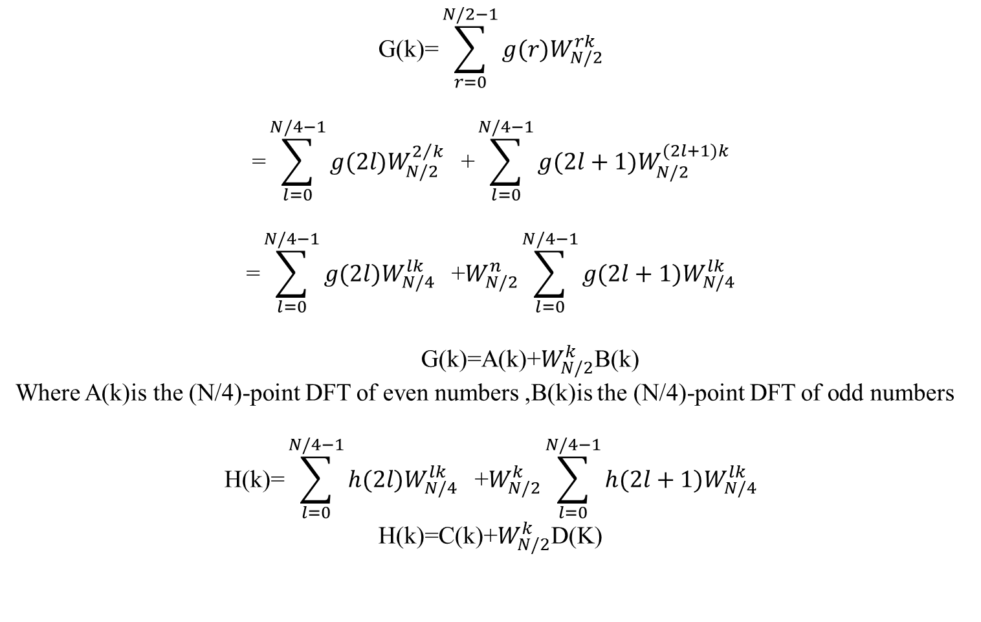
$$\text{G}\text{(}\text{k}\text{)=}\sum_{r=0}^{N/2−1}{g(r)W_{N/2}^{rk}}$$
$$\text{=}\sum_{l=0}^{N/4−1}{g(2l)W_{N/2}^{2/k}}\text{ +}\sum_{l=0}^{N/4−1}{g(2l+1)W_{N/2}^{(2l+1)k}}$$
$$\text{=}\sum_{l=0}^{N/4−1}{g(2l)W_{N/4}^{lk}}\text{ +}W_{N/2}^{n}\sum_{l=0}^{N/4−1}{g(2l+1)W_{N/4}^{lk}}$$
G(k)=A(k)+$W_{N/2}^{k}$B(k)
Where A(k)is the (N/4)-point DFT of even numbers ,B(k)is the (N/4)-point DFT of odd numbers
$$\text{H}\text{(}\text{k}\text{)=}\sum_{l=0}^{N/4−1}{h(2l)W_{N/4}^{lk}}\text{ +}W_{N/2}^{k}\sum_{l=0}^{N/4−1}{h(2l+1)W_{N/4}^{lk}}$$
H(k)=C(k)+$W_{N/2}^{k}$D(K)

Slide 10
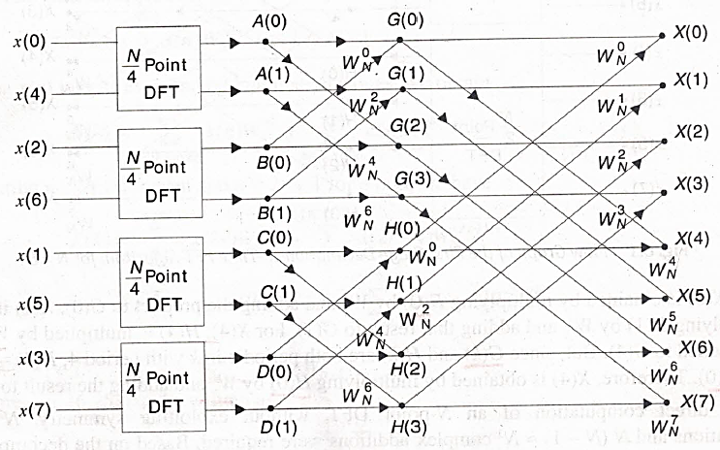
Figure:2 Flow Graph of second Decimation –in –time FFT algorithm for N=8

Slide 11
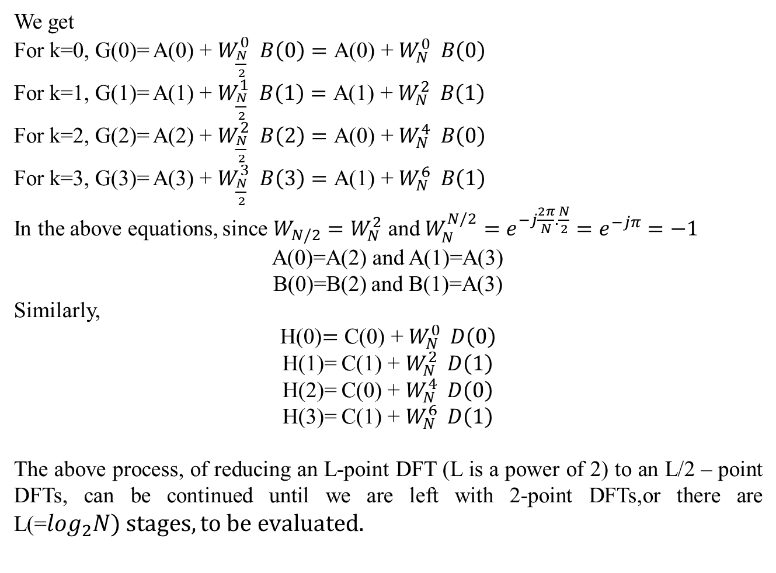
We get
For k=0, G(0)= A(0) + $W_{\frac{N}{2}}^{0} B\left(0\right)=\text{A}\text{(0) + }W_{N}^{0} B\left(0\right)$
For k=1, G(1)= A(1) + $W_{\frac{N}{2}}^{1} B\left(1\right)=\text{A}\text{(1) + }W_{N}^{2} B\left(1\right)$
For k=2, G(2)= A(2) + $W_{\frac{N}{2}}^{2} B\left(2\right)=\text{A}\text{(0) + }W_{N}^{4} B\left(0\right)$
For k=3, G(3)= A(3) + $W_{\frac{N}{2}}^{3} B\left(3\right)=\text{A}\text{(1) + }W_{N}^{6} B\left(1\right)$
In the above equations, since $W_{N/2}=W_{N}^{2}$ and $W_{N}^{N/2}=e^{−j\frac{2π}{N}.\frac{N}{2}}=e^{−jπ}=−1$
A(0)=A(2) and A(1)=A(3)
B(0)=B(2) and B(1)=A(3)
Similarly,
H(0)$=\text{C}\text{(0) + }W_{N}^{0} D\left(0\right)$
H(1)= $\text{C}\text{(1) + }W_{N}^{2} D\left(1\right)$
H(2)= $\text{C}\text{(0) + }W_{N}^{4} D\left(0\right)$
H(3)= $\text{C}\text{(1) + }W_{N}^{6} D\left(1\right)$
The above process, of reducing an L-point DFT (L is a power of 2) to an L/2 – point DFTs, can be continued until we are left with 2-point DFTs,or there are L(=$\log_{2}N) stages, to be evaluated.$

Slide 12
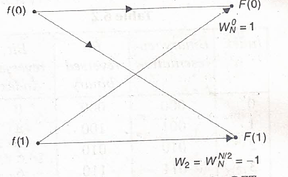
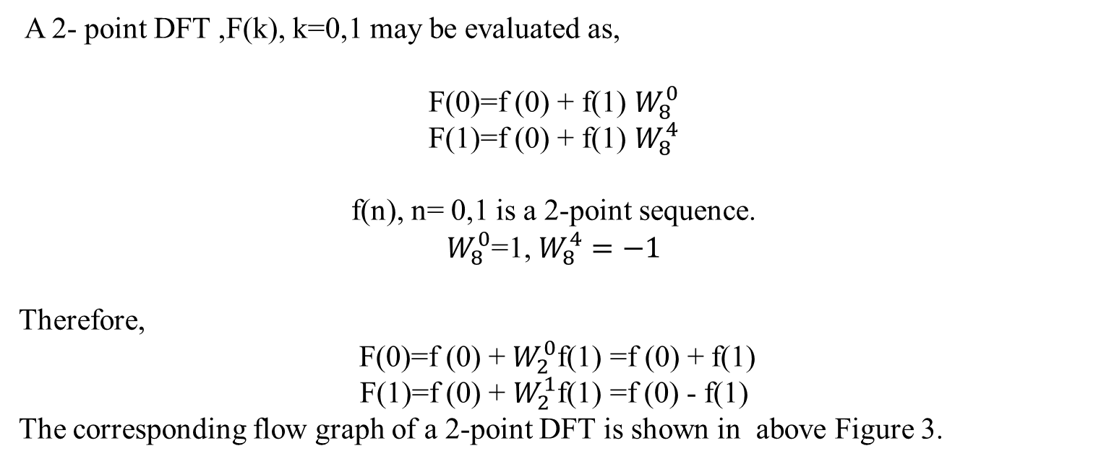
A 2- point DFT ,F(k), k=0,1 may be evaluated as,
F(0)=f (0) + f(1) $W_{8}^{0}$
F(1)=f (0) + f(1) $W_{8}^{4}$
f(n), n= 0,1 is a 2-point sequence.
$W_{8}^{0}$=1, $W_{8}^{4}=−1$
Therefore,
F(0)=f (0) + $W_{2}^{0}$f(1) =f (0) + f(1)
F(1)=f (0) + $W_{2}^{1}$f(1) =f (0) - f(1)
The corresponding flow graph of a 2-point DFT is shown in above Figure 3.
Figure: 3 Flow Graph of a 2- point DFT

Slide 13
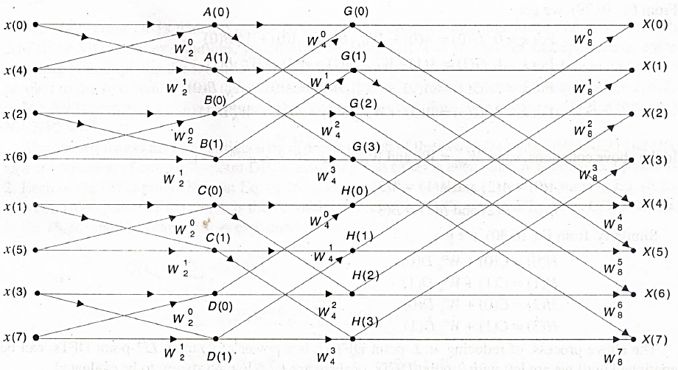
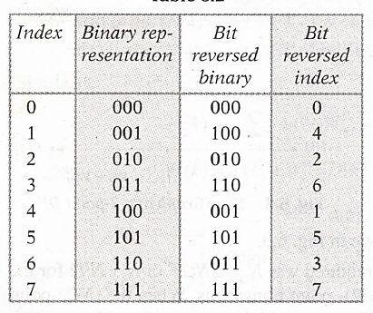
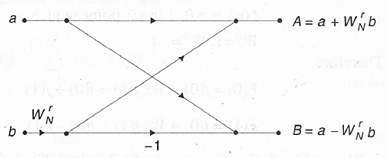
Figure: 4 The Flow-Graph of the decimation-in-time FFT Algorithm for N=8
Figure: 5 Basic Butterfly Flow Graph for the computation in the DIT FFT Algorithm
Table:1

Slide 14
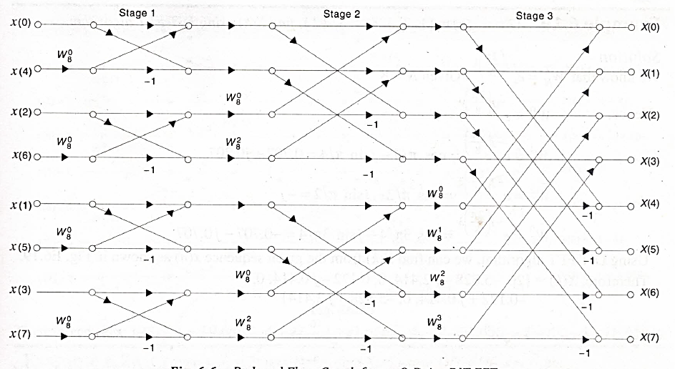
Figure: 6 Reduced Flow- Graph for an 8-Point DIT FFT

Slide 15
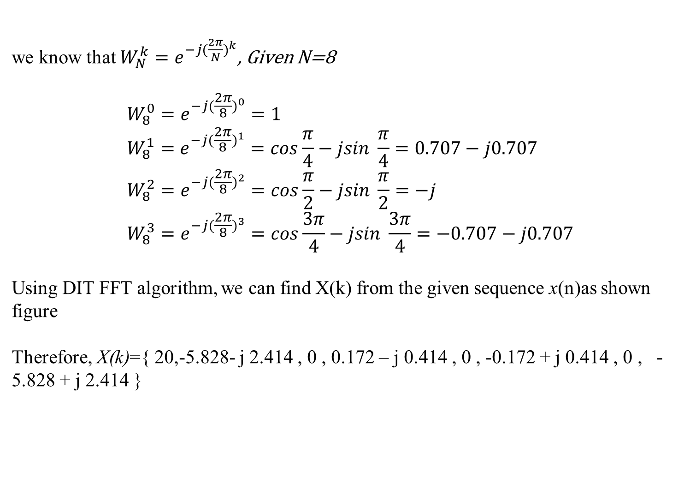
we know that $W_{N}^{k}=e^{{−j(\frac{2π}{N})}^{k}}$, Given N=8 $$W_{8}^{0}=e^{{−j(\frac{2π}{8})}^{0}}=1 \\ W_{8}^{1}=e^{{−j(\frac{2π}{8})}^{1}}=cos\frac{π}{4}−jsin \frac{π}{4}=0.707−j0.707 \\ W_{8}^{2}=e^{{−j(\frac{2π}{8})}^{2}}=cos\frac{π}{2}−jsin \frac{π}{2}=−j \\ W_{8}^{3}=e^{{−j(\frac{2π}{8})}^{3}}=cos\frac{3π}{4}−jsin \frac{3π}{4}=−0.707−j0.707$$ Using DIT FFT algorithm, we can find X(k) from the given sequence x(n)as shown figure Therefore, X(k)={ 20,-5.828- j 2.414 , 0 , 0.172 – j 0.414 , 0 , -0.172 + j 0.414 , 0 , -5.828 + j 2.414 }
Example. Given x(n)={1,2,3,4,4,3,2,1},find X(k)using DIT FFT algorithm. Solution:

Slide 16
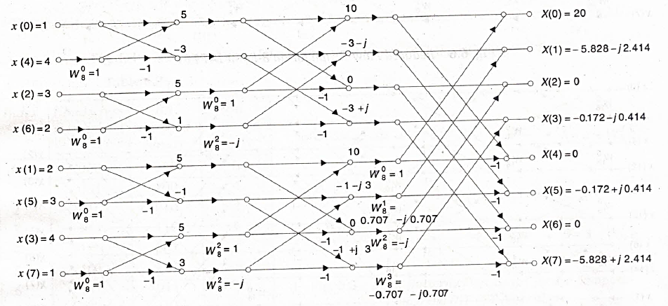
Figure :7 X(k) from the given sequence x(n)

